Slide 1

Nations’ Response to Covid-19: A Critical Look
By Keshav Narasimhan
Upper St. Clair High School

Slide 2

Why I chose this Project?
Covid-19 is a pandemic that has claimed over 400,000 lives in the US.
Despite having some of the most advanced medical infrastructure in the world, the United States has failed to contain this pandemic.
I wanted to understand if there are a few key factors which could have helped the US and other nations minimize the impact of this pandemic. If so, I wanted to find out what those factors are.

Slide 3
Hypotheses
Hypothesis # 1
Countries with an overall higher population density will have more cases per 1 million due to proximity, making the virus easier to spread.
Explanation: Higher population density will make social distancing lot more challenging, and the virus will spread easier.
Hypothesis # 2
Economic prosperity will not be as important of a variable when determining if a country successfully controlled the virus.
Explanation: By following the news, I knew that countries like the US, Germany and Belgium had a hard time controlling this virus.

Slide 4
Data Analyses Approach
Collect worldwide COVID-19 data from credible databases
Initially, keep the analysis as broad as possible. Collect data on all the countries.
Visually look for trends by plotting scatter plots.
Narrow down the countries to analyze based on the trust factor of the data; maintain adequate diversity in the countries chosen for analysis.
Construct a regression model to predict the number of cases/deaths
Statistically analyze the explanatory variables for inherent correlation.
Refine the model using R program to get the best fit. (high adjusted R-square value.)
Arrive at key conclusions from the model.

Slide 5
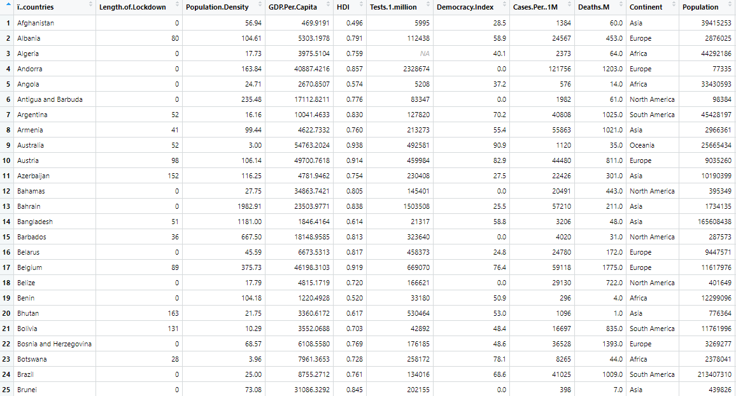
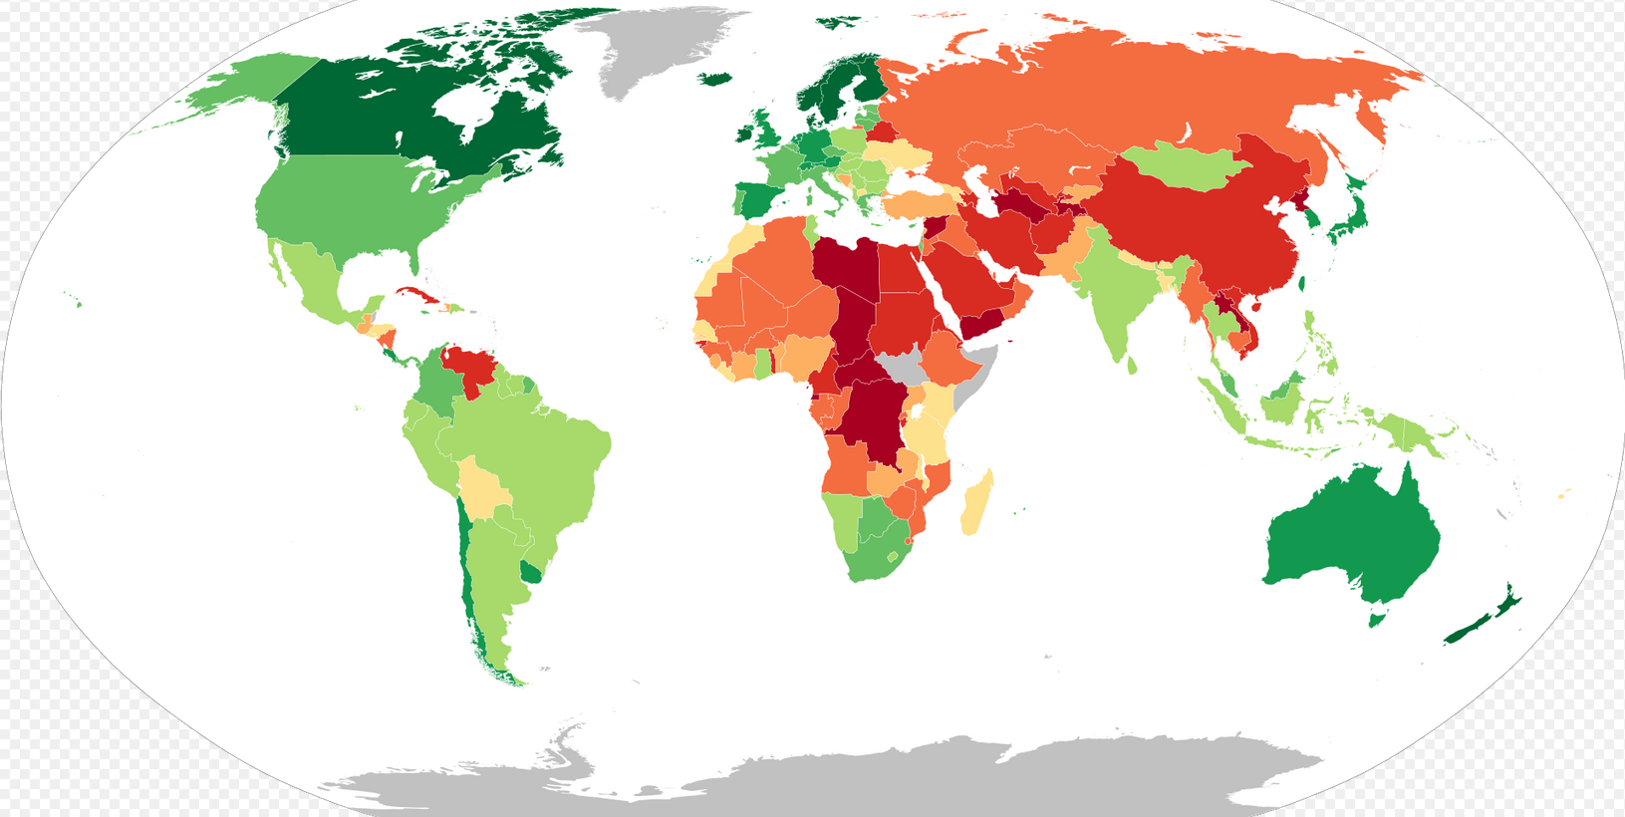
Data Collection
Source: Worldometer Website
www.worldometer.com
Response Variable:
No. of Covid-19 cases
No. of Covid- 19 deaths
Explanatory Variable:
Population density
GDP Per Capita
Human Development Index (HDI)
Tests per million
Democracy Index
Length of Lockdown.
Mask Mandate Implementation
Graphical Representation of Democracy Index.
Source: Economist Intelligence Unit
Dark Green – More Democratic
Dark Red – Less Democratic
*Note China, a highly populated country is very red. Therefore, I will be excluding this country.

Slide 6
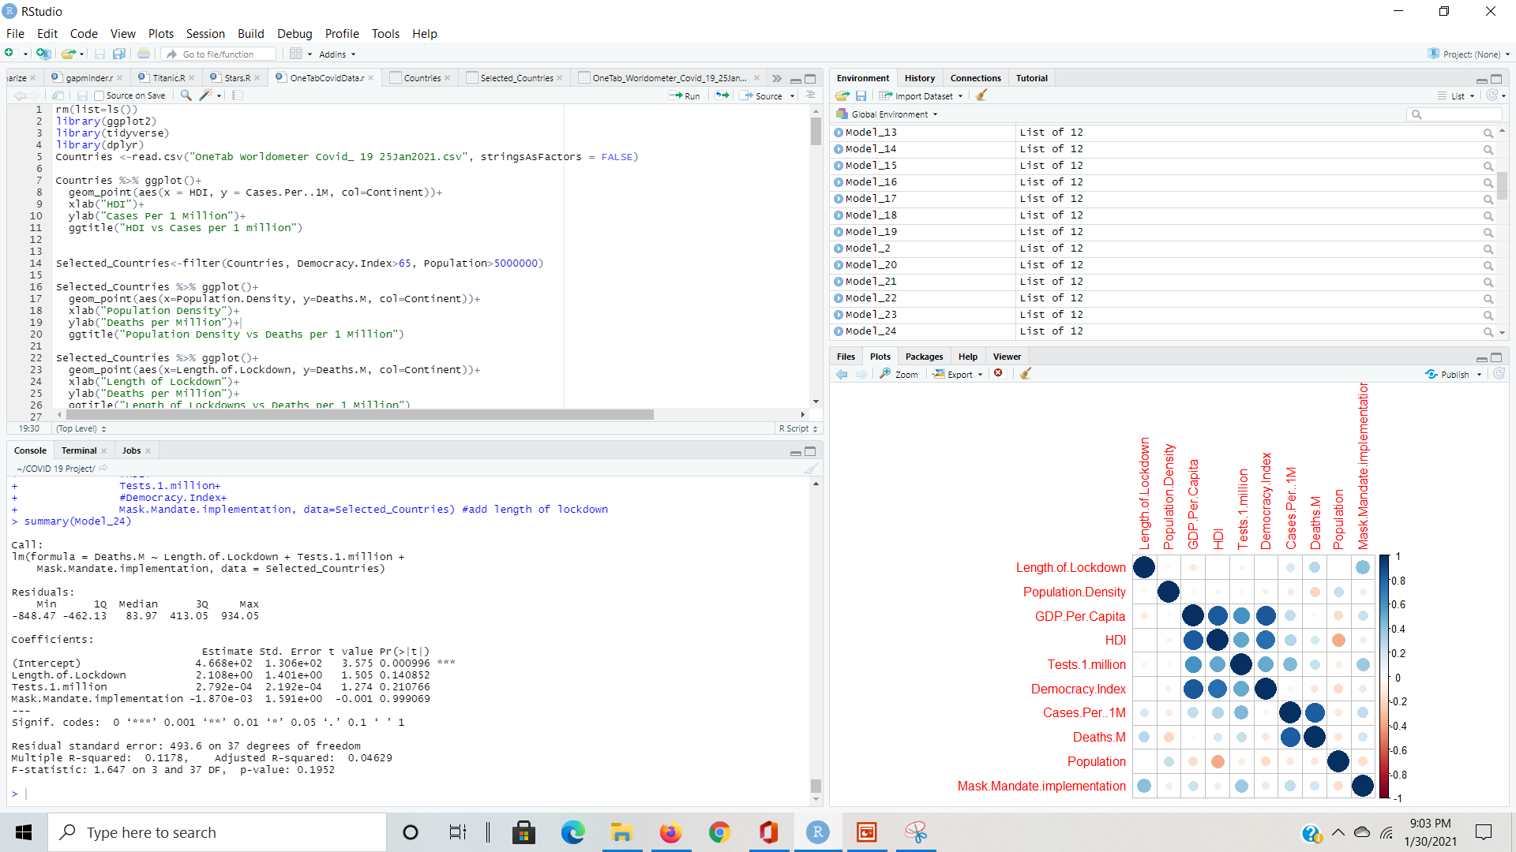
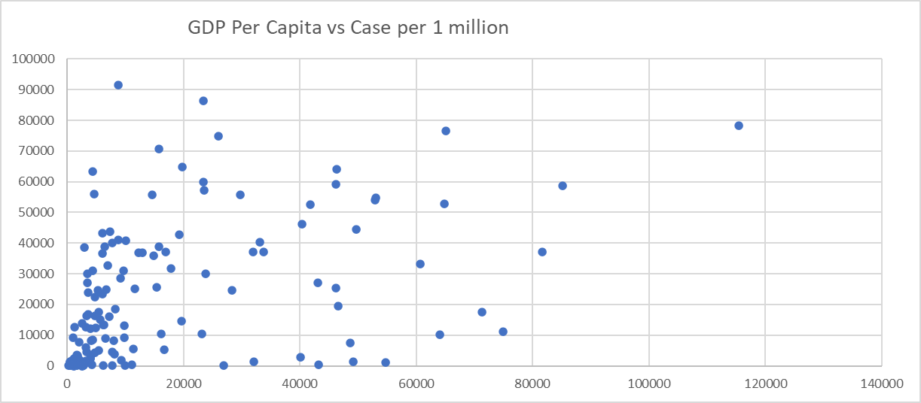
Statistical Program
R-Studio
Excel
I used statistical program
R studio in conjunction with
Excel to look for trends.

Slide 7
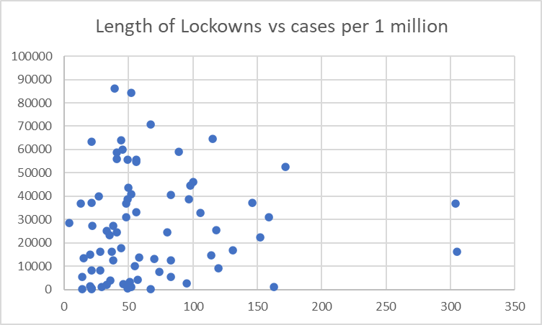
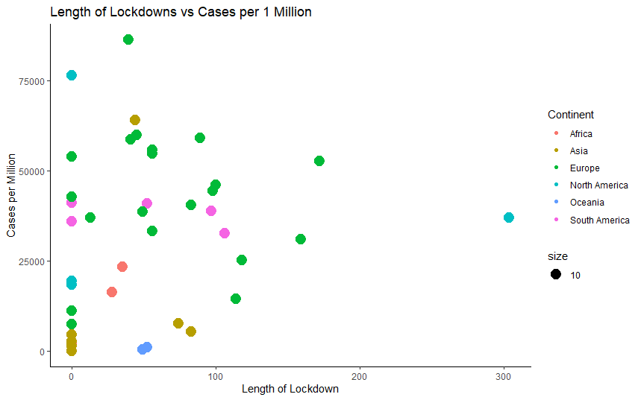
Scatter Plots to Search for Trends
All 190 countries
41 selected countries
Looking at all 190 countries in a single scatterplot made it difficult to see any obvious patterns.
Therefore, I used two criteria to further filter the data:
1. Population > 5M (to ensure countries are chosen with a substantial number of cases and deaths)
2. Democracy Index > 65 (to ensure that a free media can monitor the accuracy of government data.)
41 countries selected based on the criteria listed above.
Even amongst these selected countries, data was still scattered and hard to spot a pattern.
This is a hard problem to solve. Will require analysis of multiple variables to predict the number of cases.

Slide 8
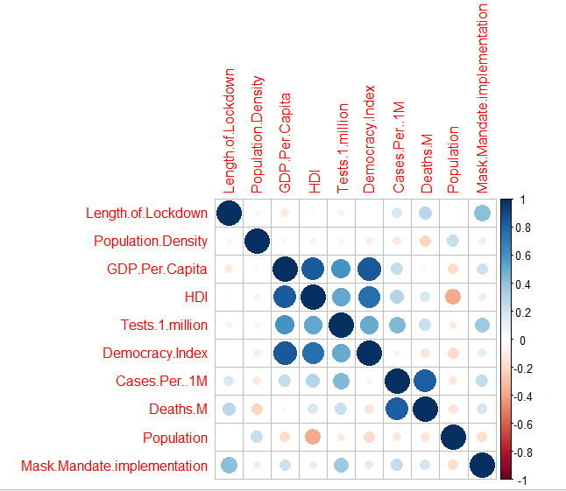

Correlation Plot in R
Since the scatterplot did not show any strong pattern, I used the R program to look for correlation statistically.
The analysis showed that the following 4 factors were strongly correlated:
GDP Per Capita
HDI
Tests per 1 million, and
Democracy Index
This meant I could potentially use fewer explanatory variables to construct the linear model. I used adjusted R-square value to confirm this.
Similarly,
Death per million, and
Cases per million
were also strongly correlated.
It might be possible to use only 1 of these two response variables.

Slide 9
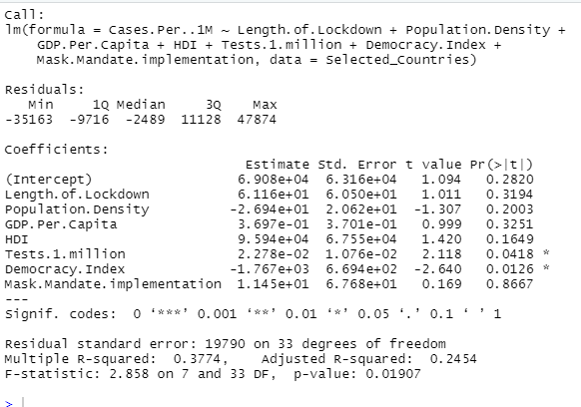
Multivariate Linear Regressions
In this model I used all 7 explanatory variables to construct the model that had an adjusted R-Squared value of 0.2454*. This is typically considered a low value.
*Note: A higher adjusted R-Squared value is better.

Slide 10
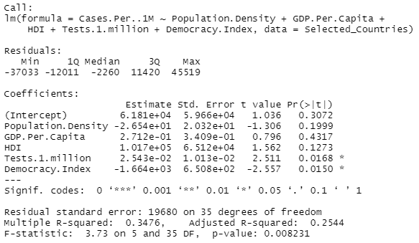
Attempts to Improve Fit…
Even after trying different combinations of the explanatory variables, this is the best adjusted R-Square value that I could get.
It proved that it is a very challenging problem to solve.

Slide 11
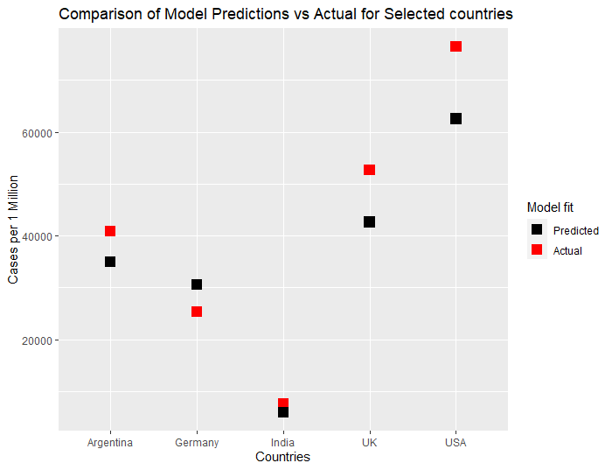
Model Vs. Actual
Economically prosperous countries
Despite the model having a low adjusted R-Square value, the model is reasonably good in predicting the cases per 1 million.
Country with high population density

Slide 12
Conclusions
I have three conclusions to make:
My Hypothesis #1 is rejected: Data showed that the countries that had a higher population density did not show higher numbers of cases.
My hypothesis #2 is correct: Economically prosperous countries, such as USA and Germany, did not show better capability in controlling the number of Covid-19 cases.
Predicting the number of cases in a country is a very difficult task. No one single factor was more dominant than the others in predicting the number of Covid-19 cases.

